Slide 1

SMART PARKING SYSTEM
BASED ON
INTERNET OF THINGS
Under the esteemed Guidance of
Dr.A. Rama Mohan Reddy
SUBMITTED BY(BATCH-II)
Shravani Anumula - 11506002
Sai Krishna Gudipati - 11506010
Sharukh Basha Kattubadi - 11506017

Slide 2
Contents:
ABSTRACT
INTRODUCTION
LITERATURE SURVEY
PROPOSED SYSTEM
SYSTEM DESIGN
RESULTS
CONCLUSION

Slide 3
ABSTRACT:
People owning vehicles face parking problems in most metropolitan area, especially during peak hours.
The proposed Smart Parking system consists of an on-site deployment of an IoT module that is used to monitor and signalize the state of availability of each single parking space.
A web application is also provided that allows an end user to check the availability of parking space and book a parking slot accordingly
Our proposed system is within low cost and less time to build it.

Slide 4
INTRODUCTION:
Physical Object + Controller, Sensor and Actuators + Internet= IoT
Advanced Technologies for
Efficient Operation
Monitoring
Management
Smart application for
Customer services
Mobile payments
Car navigation systems

Slide 5
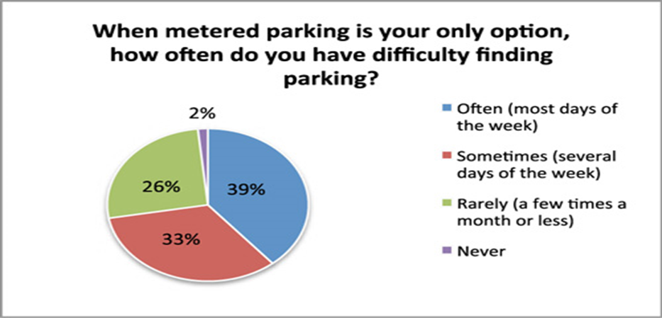

Slide 6
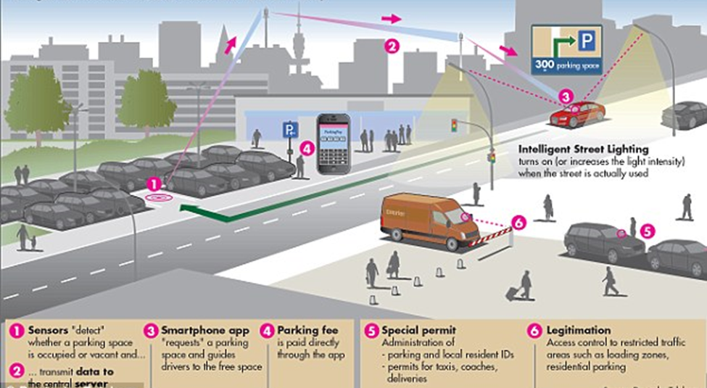

Slide 7
LITERATURE SURVEY:
Bryan Peering from base town center
Better source of revenue generating upto 250% rent in span of 10 years
Multiple companies expressed interest
Potential Benefits
43% less time spent looking for parking.
30% less parking related vehicle kilometers travelled.
8% less traffic volume when increase in parking availability.
CO2 gas reduction in emission.

Slide 8
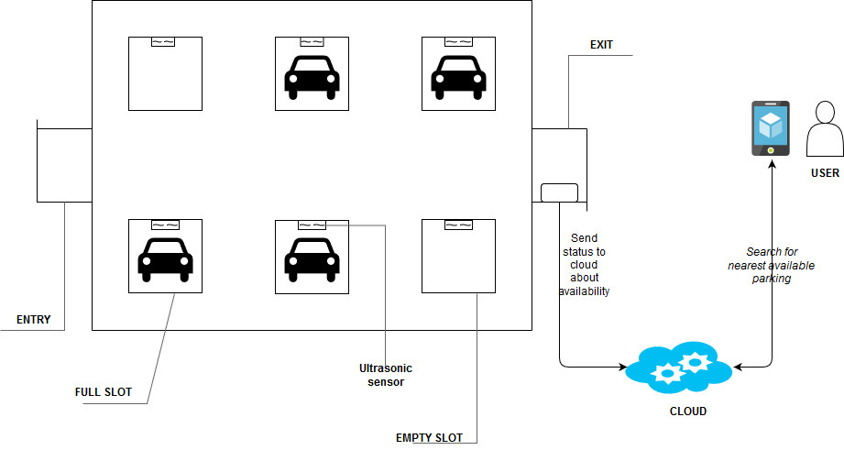
PROPOSED SYSTEM :

Slide 9
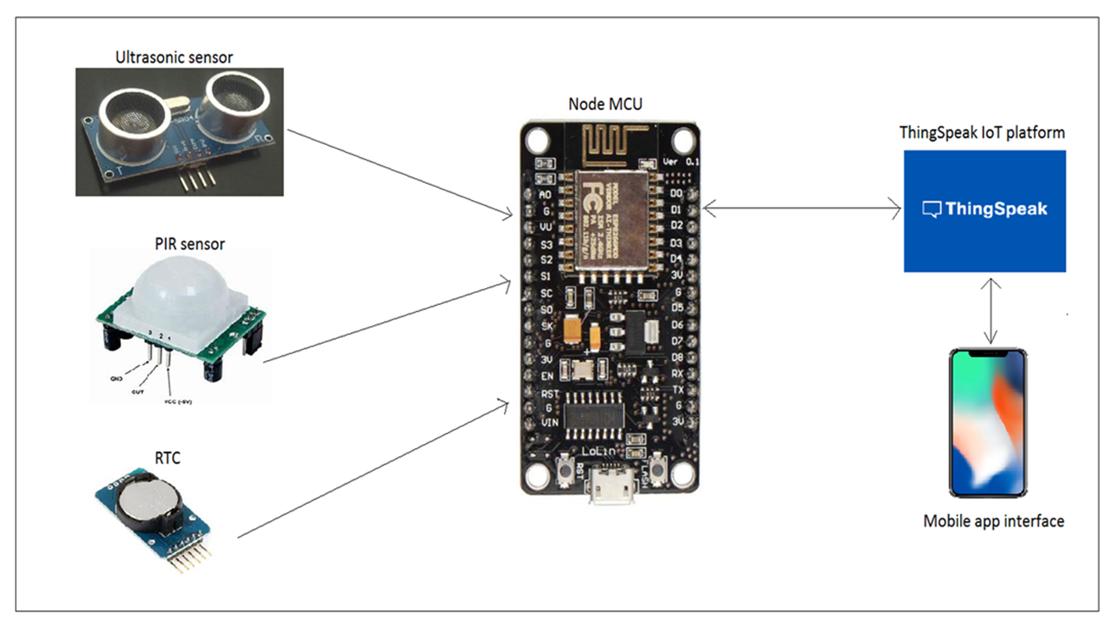
BASIC COMPONENTS:
Hardware Components:
1. HC-SR04 Ultrasonic
2. Node MCU
3. RTC DS3231
Software Environment:
1. Arduino Integrated development
environment (IDE)
2. ThingSpeak IoT platform
3. ESP8266 Library
4. ANGULAR JS

Slide 10
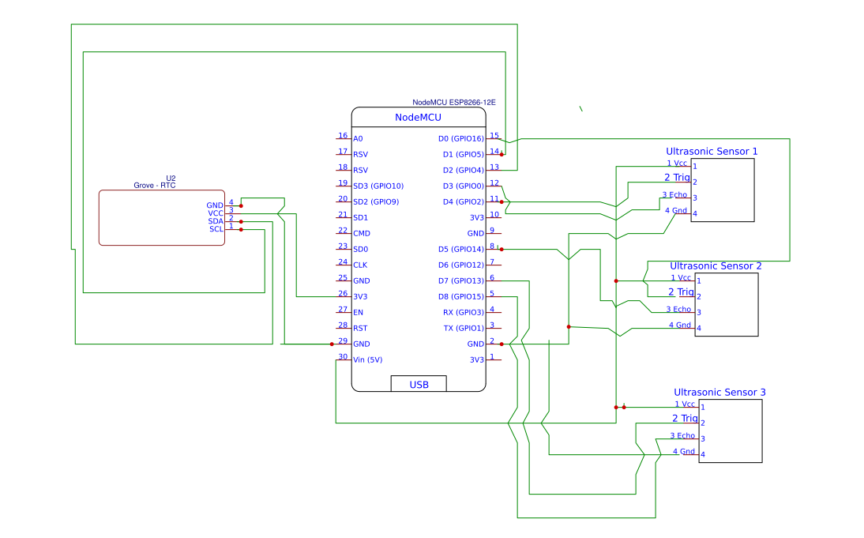
SYSTEM DESIGN:

Slide 11
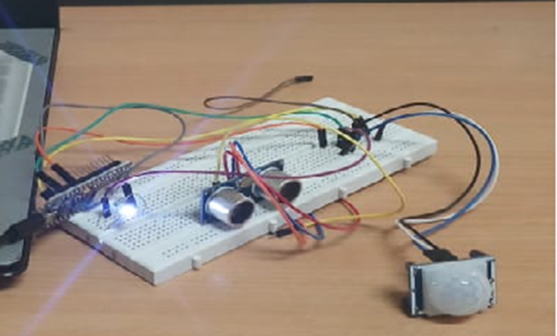
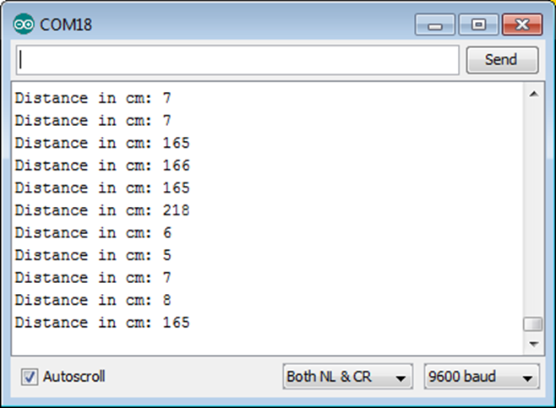
RESULTS:

Slide 12
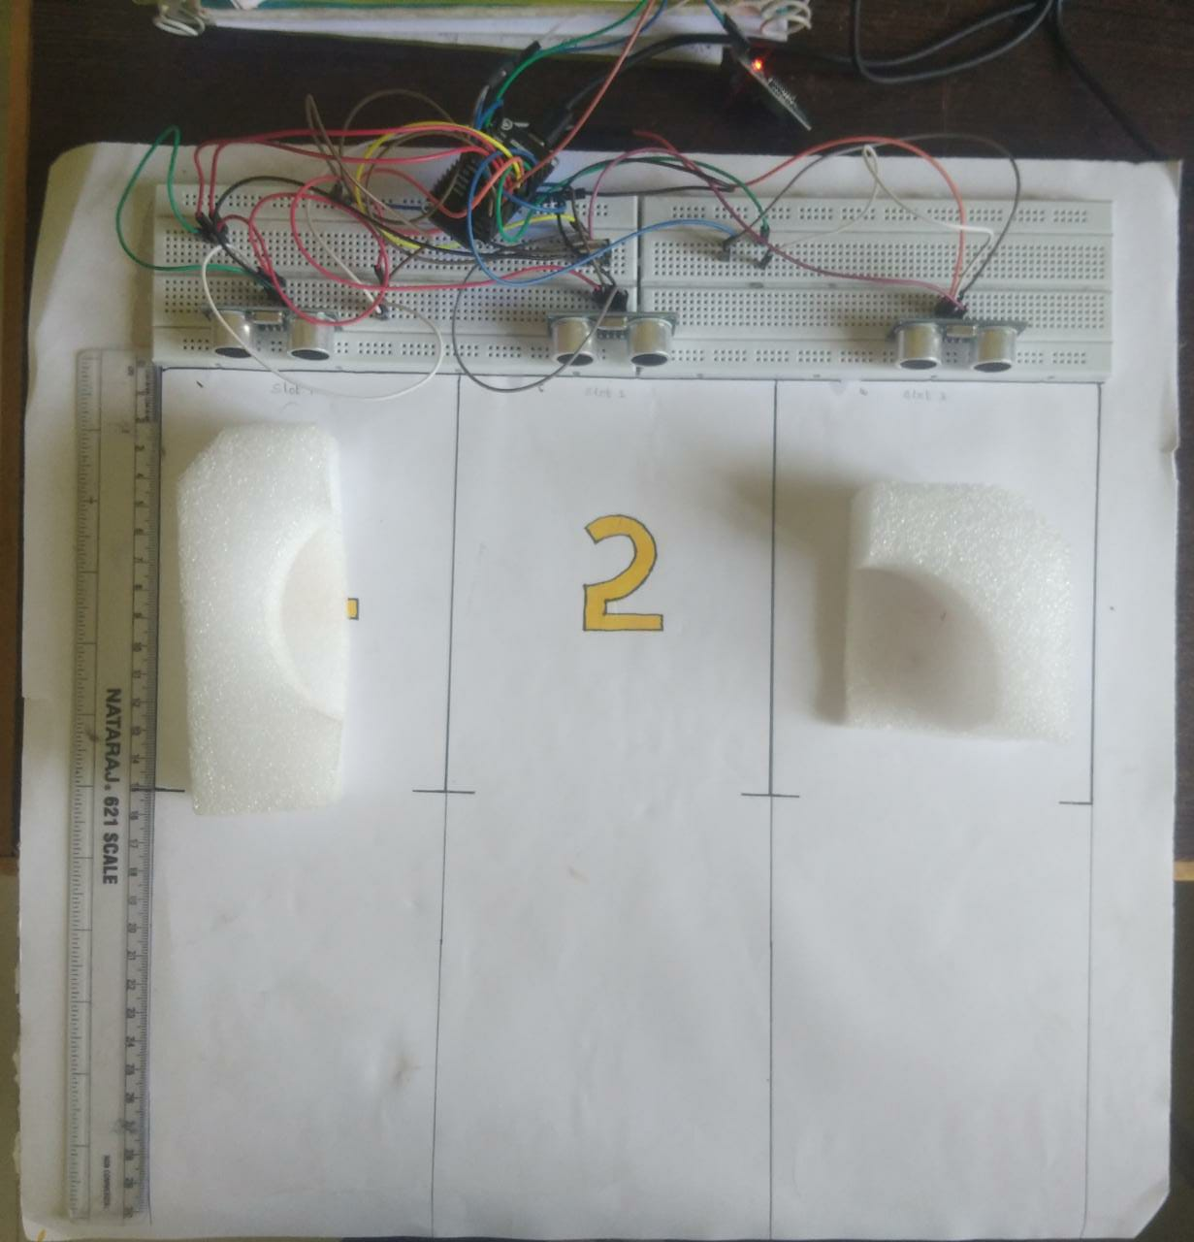
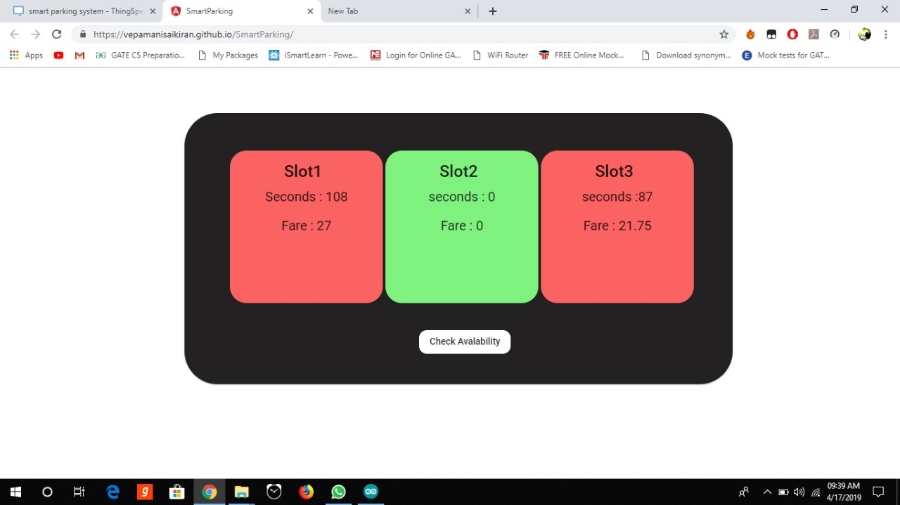
status of parking slots in web app when slots 1 and 3 are busy

Slide 13
CONCLUSION:
This system helps people who want to park their vehicles in the crowd areas.
They can reserve a parking slot prior to their journey without worrying about parking.
The development of these system reduces the traffic in parking areas with the advanced reservation
Can see the status of the parking zone through the app.
Prevents parking zone authorities from collecting abnormal parking fares
and provides a normal charge.

Slide 14
References:
https://www.researchgate.net/publication/303842610_IoT_based_Smart_Parking_System
https://www.sciencedirect.com/science/article/pii/S1877042812043042
https://github.com/arc13-13/Smart-Car-Parking-System/find/master?q
https://ieeexplore.ieee.org/document/7562735
https://www.ukessays.com/essays/information-technology/literature
-review-on-car-parking-system-information-technology-essay.php

Slide 15
ANY QUERIES?

Slide 16
THANK YOU

